Slide 1
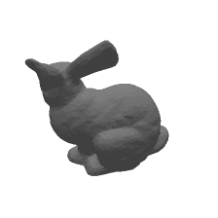
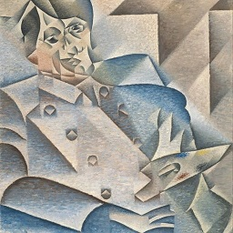
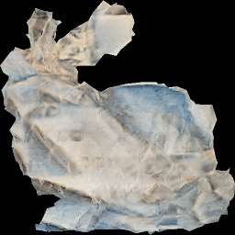
Gradient-based 3D mesh style transfer using 2D supervision
Abhishek Lalwani, Himanshu Gupta, and Rushikesh Dudhat
University of Massachusetts Amherst

Slide 2
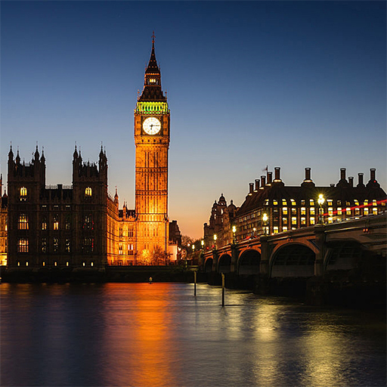
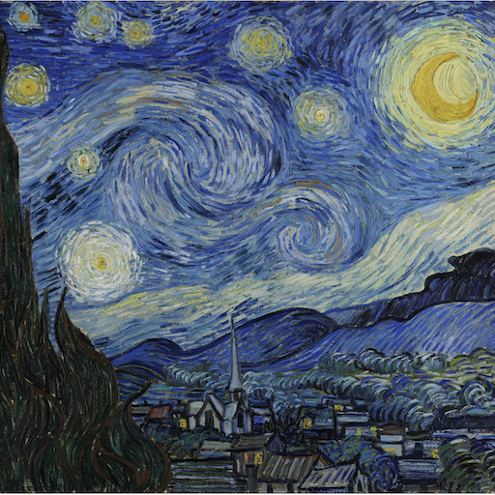
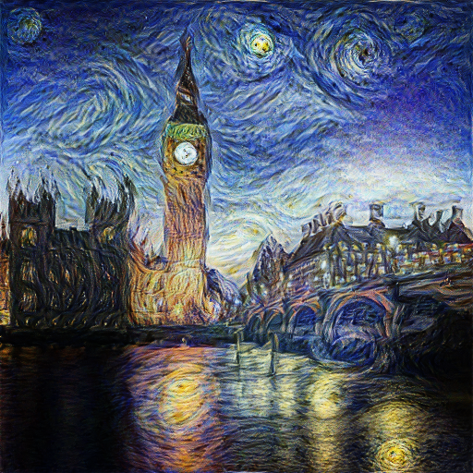
Background
2D Style Transfer

Slide 3
Background
2D Style Transfer
Convolutional Neural Network (CNNs) have achieved considerable success in 2D image understanding in recent years.
Rendering into neural networks has a high potential in 3D world.

Slide 4
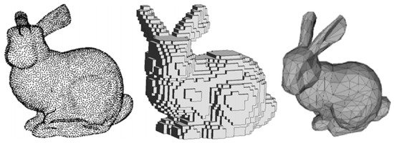
Background
3D Representations:
Point-Cloud vs Voxel vs Mesh
Voxel: Difficult to process high resolution voxels. Memory and computation inefficient.
Point-Cloud: Do not have surfaces. Difficult to apply texture and lighting.

Slide 5
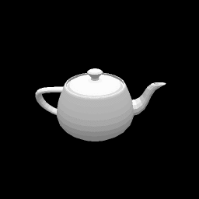
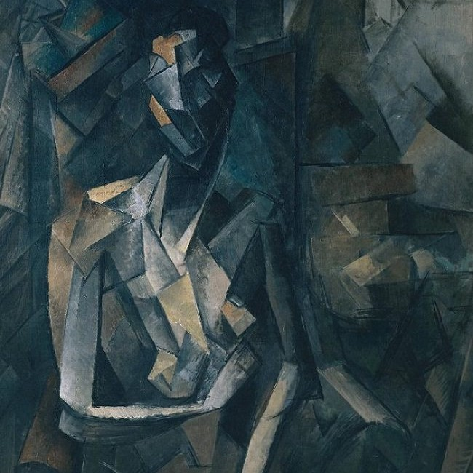
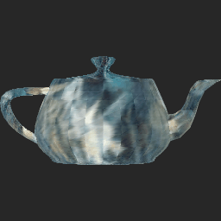
Texture Mapping

Slide 6
Texture Mapping
Does not capture shape changes.
Neural renderer provides a way to edit 3D models intuitively and quickly.
Can be useful in rapid prototyping for product design as well as art production.

Slide 7
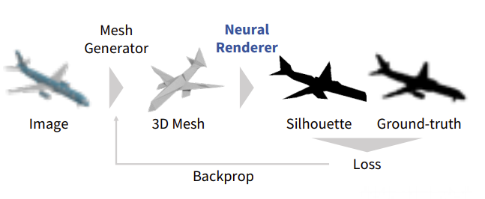
Neural Rendering
H. Kato, Y. Ushiku, and T. Harada. Neural 3d mesh renderer. In Proceedings of the IEEE Conference on Computer Vision and Pattern Recognition, pages 3907–3916, 2018.

Slide 8
Neural Rendering
Conversion from a mesh to an image, or Rendering, involves a discrete operation called rasterization, which prevents back-propagation.
Solved using approximate gradients for rasterization.
H. Kato, Y. Ushiku, and T. Harada. Neural 3d mesh renderer. In Proceedings of the IEEE Conference on Computer Vision and Pattern Recognition, pages 3907–3916, 2018.

Slide 9
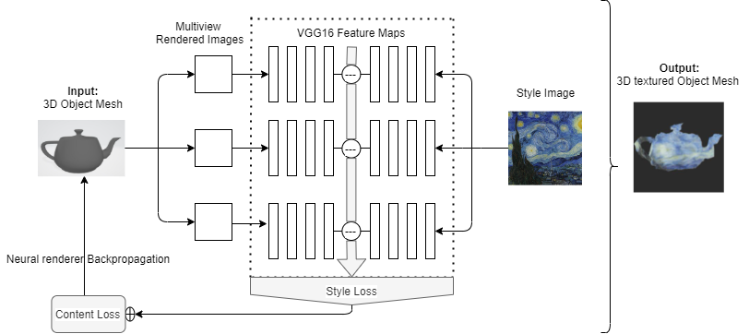
Architecture

Slide 10
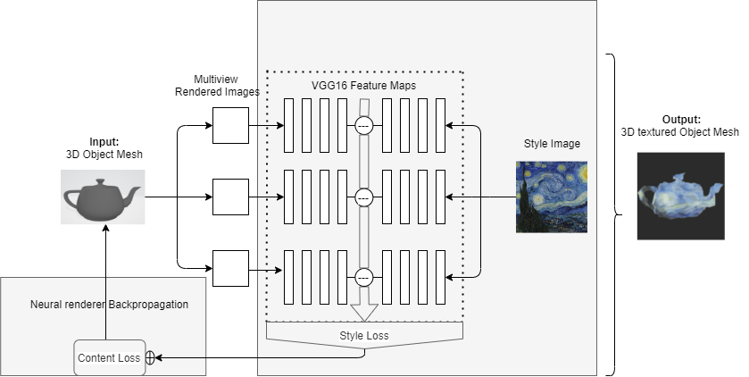
Implemented Architecture
Pytorch Implementation

Slide 11
Chainer vs Pytorch
Removed dependencies on chainer and other older frameworks.
Pipeline now running on latest versions of libraries: Pytorch, CUDA 11.2
Easier to setup
Easier to run

Slide 12
Training Errors
Content Loss: Between original mesh and deformed mesh.
Style Loss: Between vgg16 feature maps of rendered and style images.
TV Loss: Between Adjacent pixels of rendered images.
Optimizer: (Wc * Content Loss) + (Ws * Style Loss) + (Wtv * TV Loss)

Slide 13
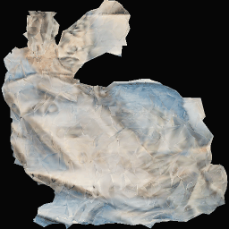
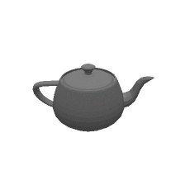
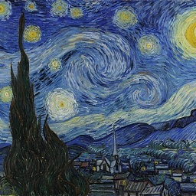
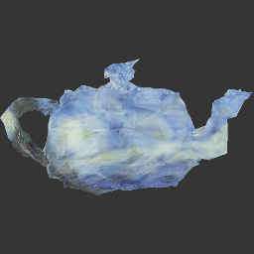
Results
Object Meshes(.obj) Style Images(.jpg): Output(.obj)

Slide 14
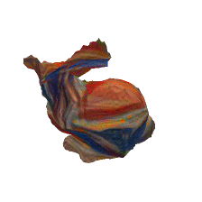
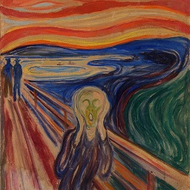
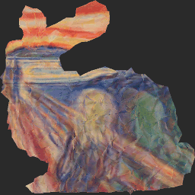
Comparison with Baseline
Baseline
Our Work

Slide 15
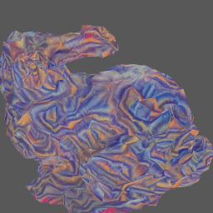
Comparison with Baseline
Baseline
Our Work
Before Explicit Texture mapping
After Explicit Texture mapping

Slide 16
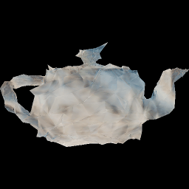
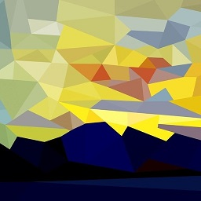
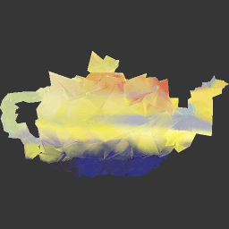

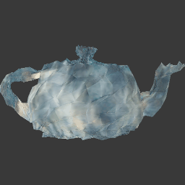
Observations

Slide 17
Summary
Mesh vs other topologies for texture representation.
Rendering for mesh editing.
Leveraging 2D style transfer in the world of 3D.
Implemented a Pytorch version of already existing Neural renderer based 3D style transfer model.

Slide 18
Future Works
Experimenting with dynamic learning rate to adopt for every texture object combination.
Style transfer using other optimized loss functions, like one used in cycle GANs.
Use different network for feature extraction like ResNet and compare the performance.
Automating the calculation of optimal hyperparameter .

Slide 19
Thank You

